Slide 1
Training on Blended Learning
Date: 12th – 16th February 2024
Organized by: CIET, NCERT, New Delhi
Technology Tools and Resources in Blended Learning
February 14th, 2024; 4.00 p.m. - 5.00 p.m.
Prof. (Dr.) Manas Ranjan Panigrahi
E-mail: manaseducation@gmail.com

Slide 2
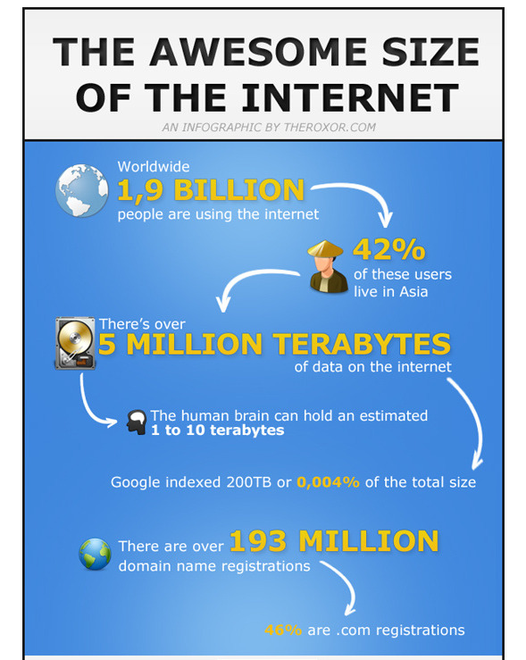
Source: http://ansonalex.com/technology/4-infographics-about-online-trends-internet-usage-and-social-media/

Slide 3
What are the Issues?
Connectivity and Electricity
Access to Learning Platforms
Learning Resources
Teachers Capacity
Learners Readiness

Slide 4


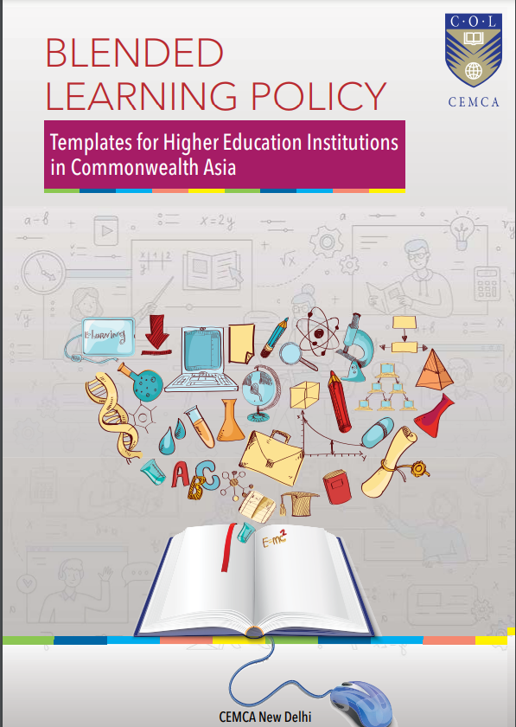

Slide 5
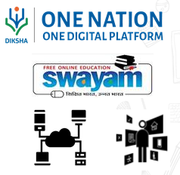


What NEP-2020 Says
Inclusion and Access: Enhance Educational Access to Disadvantaged Groups including Divyang students
Digital Platforms: Digital platforms and ongoing ICT based educational initiatives to be optimized and expanded
Blended Learning: Emphasis on effective models of blended learning
Content Creation: Content creation, digital repository, and dissemination. Technology Integration In Teaching, Learning & Assessment
Expansion of Platforms: Expansion of existing e-learning platforms - DIKSHA, SWAYAM, etc.
Pilot Studies: A series of pilot studies to be conducted

Slide 6
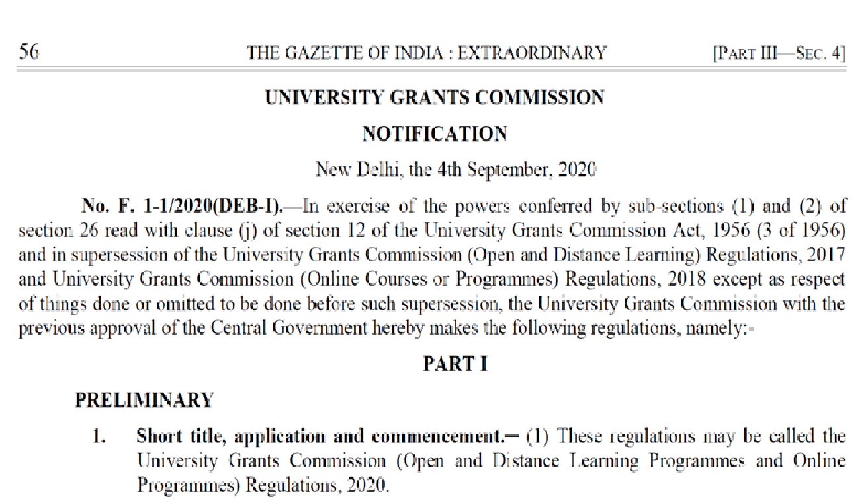

Online Regulation Says….
Highlights
•Standards for infrastructure and staff
•Instructional processes
•40% learning resources can be sourced form other sources such as Open Educational Resources
ODL and Online: 2 Modes
Multiple modes, blended
Purely online delivery

Slide 7
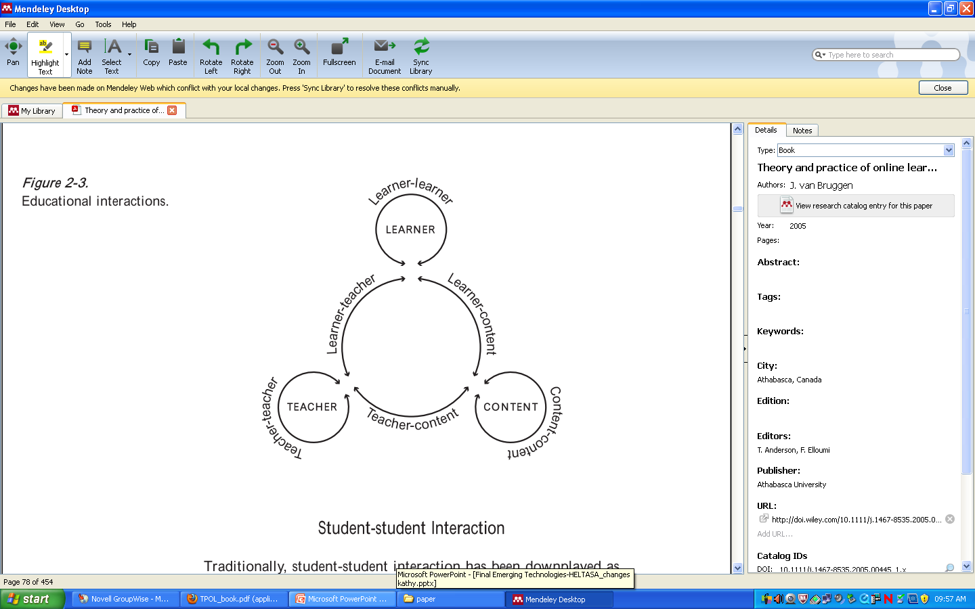

Six levels of interaction

Slide 8
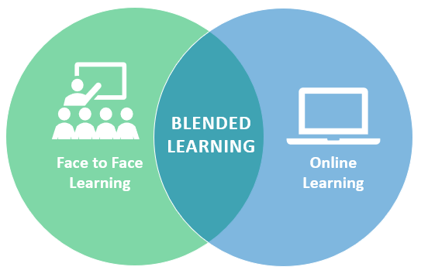
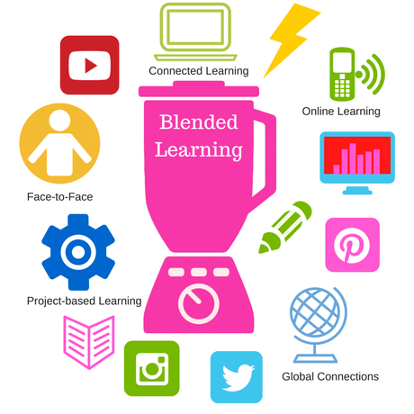
Blended Learning
It requires the physical presence of both teacher and student, with some elements of student control over time, place, path, or pace

Slide 9


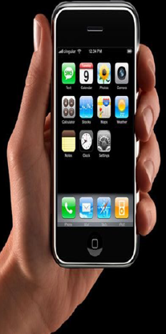



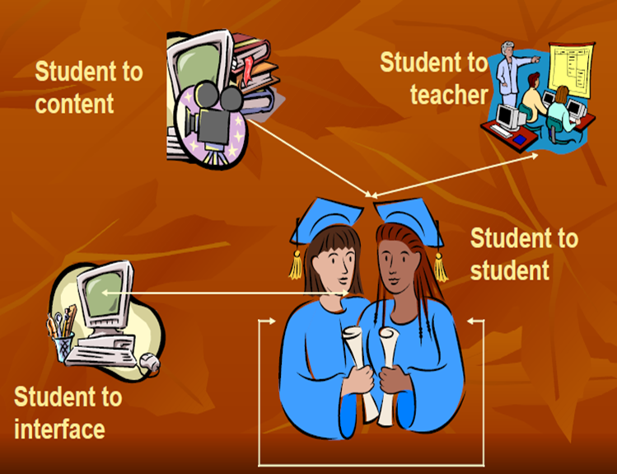

Instructional Path
Activities
Discuss
Read
Test
Watch

Slide 10
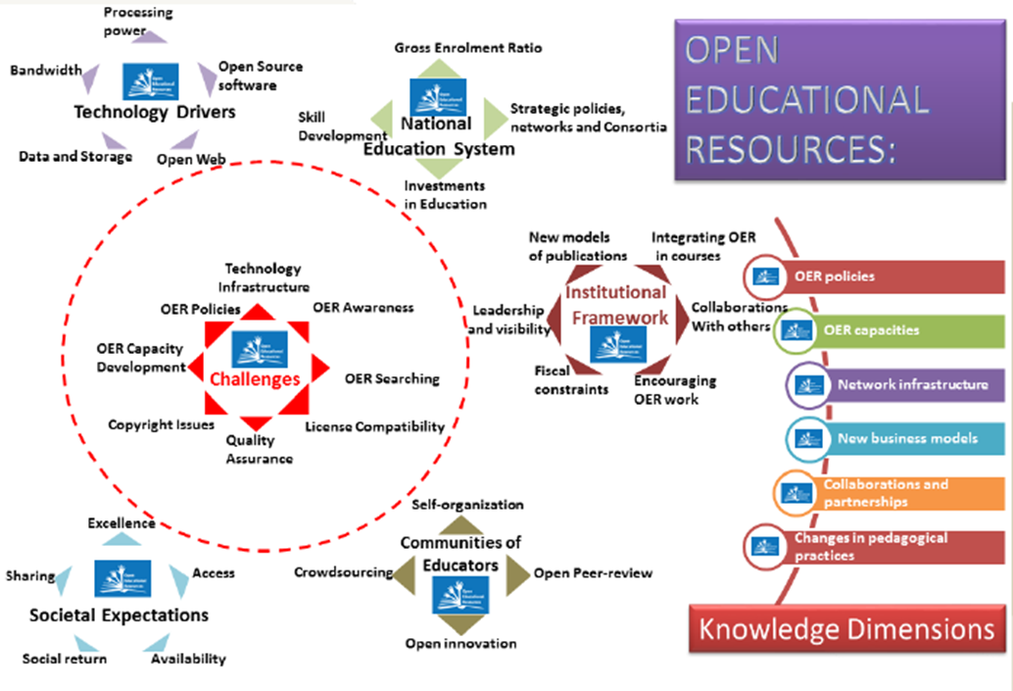
OER for Learning
OER are teaching, learning and research materials in any medium that reside in the public domain or have been released under an open license that permits their free use and, in some instances, re-purposing by others

Slide 11


























Learning Resources

Slide 12










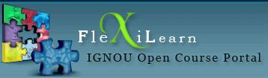
Collaborative Learning Tools
Facebook
Twitter
Social Media
Wiki Educators
Email
Wikispaces
Edmoto
ZOOM
Google Apps

Slide 13
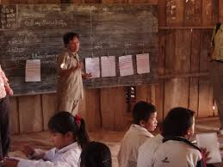
Collaborative Learning Tools
Kahoot
Online Quizzes
Google Classroom
Hot Potatoes
Canva
ZOOM breakout rooms
Google Forms
https://pxhere.com/en/photo/826379

Slide 14








What institutions are using…

Slide 15









What are students using?

Slide 16
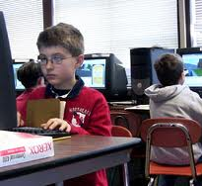
New Opportunities

Slide 17
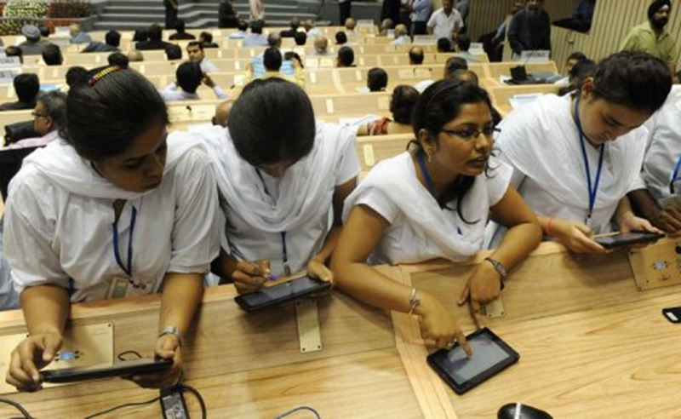
21st Century Indian Learners
Net Generation
Millennials
Digital Natives
Multi-taskers
Image source: http://phys.org/news/2012-01-million-world-cheapest-tablet-india.html

Slide 18

Social Media
Social media is the collective of online communications channels dedicated to community-based input, interaction, content-sharing and collaboration. Websites and applications dedicated to forums, microblogging, social networking, social bookmarking, social curation, and wikis are among the different types of social media.

Slide 19


Big data … Learning Analytics

Slide 20

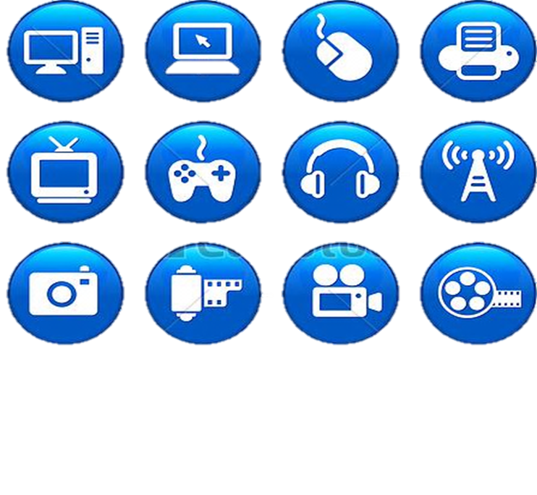
AR, VR, AI, ChatGPT, Virtual Lab, O-Lab, Robotics, etc.

Slide 21

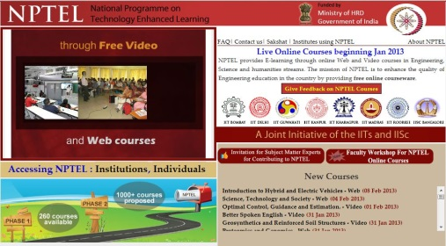
Learning ways… …

Slide 22


Thank You
The contents of this presentation, except logos/ graphics which are property of the respective owners, is made available under Attribution-ShareAlike 4.0 International (CC BY-SA 4.0).

